Slide 1

Predicting apartment prices in Skopje
Elena Stefanovska (171503)
Marija Velichkovska (171517)

Slide 2
Overview
Buying a new apartment - daunting process that often seems impulsive or risky
Data Science pipeline for apartment price prediction in Skopje
The biggest challenge along the way: handling the missing and noisy data, cleaning the inconsistent and duplicate records, trying to improve the metrics of our regression models.
Attributes (from ads): the place of settlement, its surface, rooms count, floor number, whether or not there is an elevator, parking and heating

Slide 3
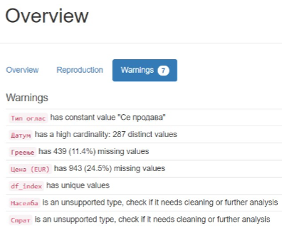
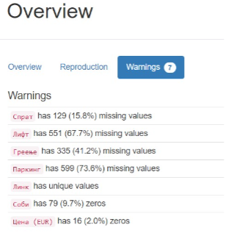
Exploratory Data Analysis
Data structured in two tables
Profile report - pandas_profiling
Visualizations, distribution of each variable, NaN values, duplicate values, variables with many zeros, categorical variables with high cardinality, different correlation matrices

Slide 4
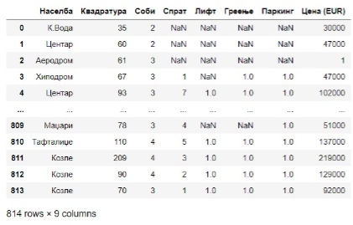
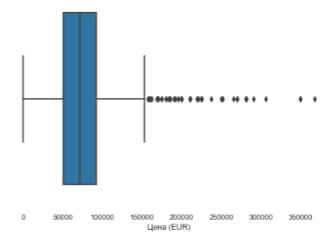
Data Preprocessing
Price range: 0 - 150 000 Euros per apartment, very small portion in the range 150 000 - 350 000 Euros (outliers, noise, bias)
invalid advertisements and missing information
Convert categorical attributes to numeric ones (“Населба”-> 0-34, “Лифт”, “Паркинг”, “Греење” -> -1,0,1)
locate and remove inconsistent string values in numeric attributes (“Спрат “ -> сутерен = -1)

Slide 5
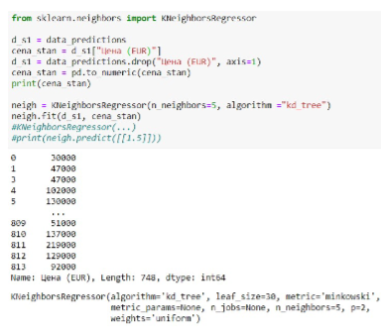
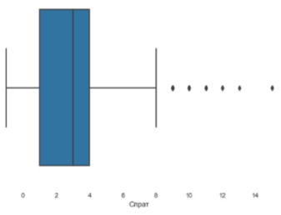
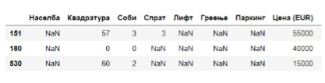
Filling Missing Values
Estimate missing values from the part of the data which is not missing.
A regressor is fit on (X,y) for known y. Then, the regressor is used to predict the missing values of y.
KNNRegressor algorithm – using a distance metric (minkowski) finds the k closest neighbors to the observation with missing attribute value
Predicting the missing values of the Price and the Floor Number attributes.
Very few records with floor number in the range 9-15.

Slide 6
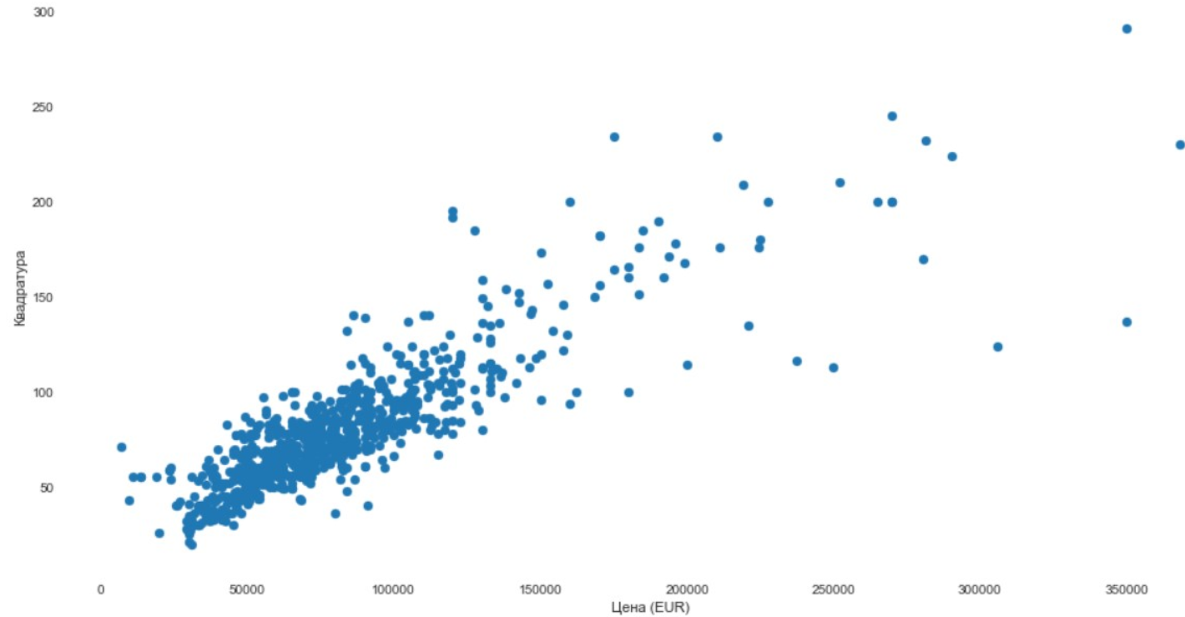
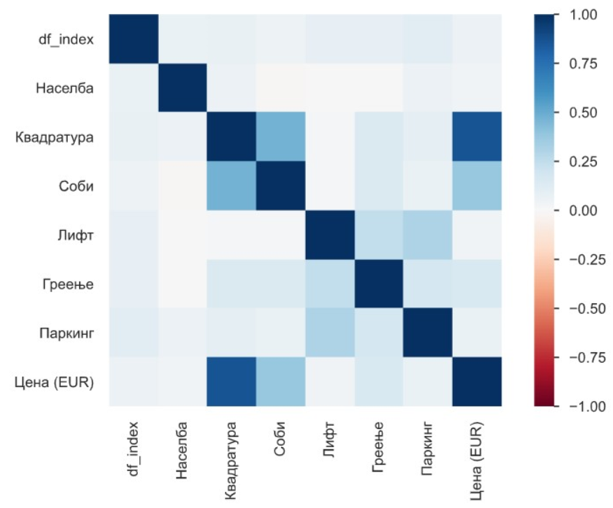
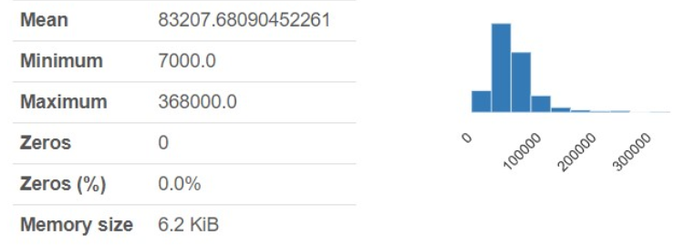
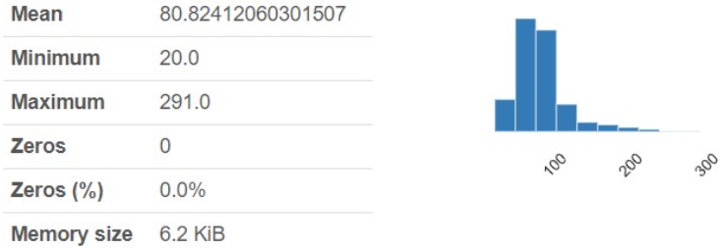
Scatter plots and Final Report
“Цена” и “Квадратура” - high linear correlation between these two features, is as expected.
Apartment’s surface has the greatest impact in determining the final price and as such will be assigned the largest weight when building the regression model.

Slide 7
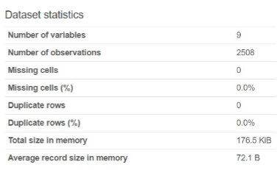
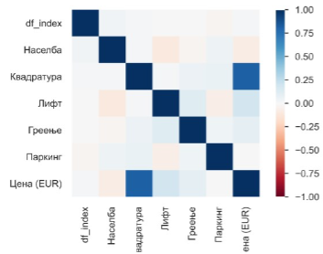
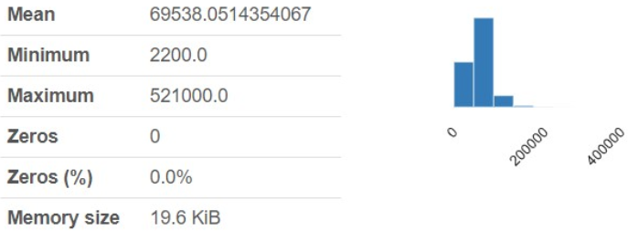
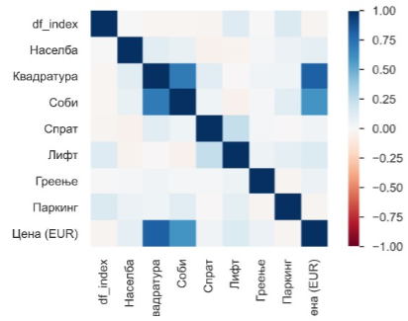
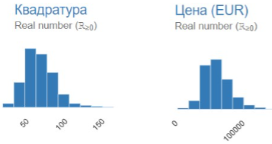
Second dataset and Anomaly detection
Apartments for rent and sale in one place (drop if below 500 Eur)
Attribute values cleaning
Isolation Forest (iForest) - tree-based anomaly detection algorithm - modeling the normal data to isolate anomalies
865 (out of 3012) outliers present - better model performance after removing them
Surface: 20-170 meters sq. •Room number: 0-5 •Price: 4086-190000 Euros

Slide 8
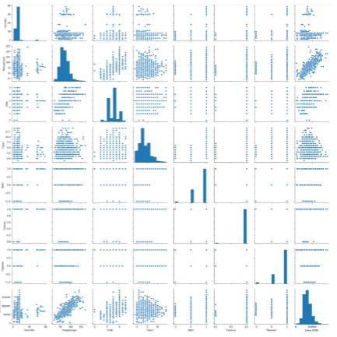
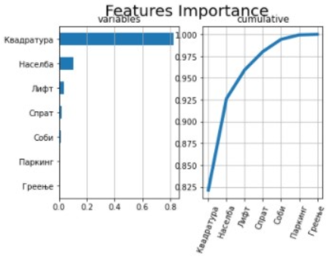
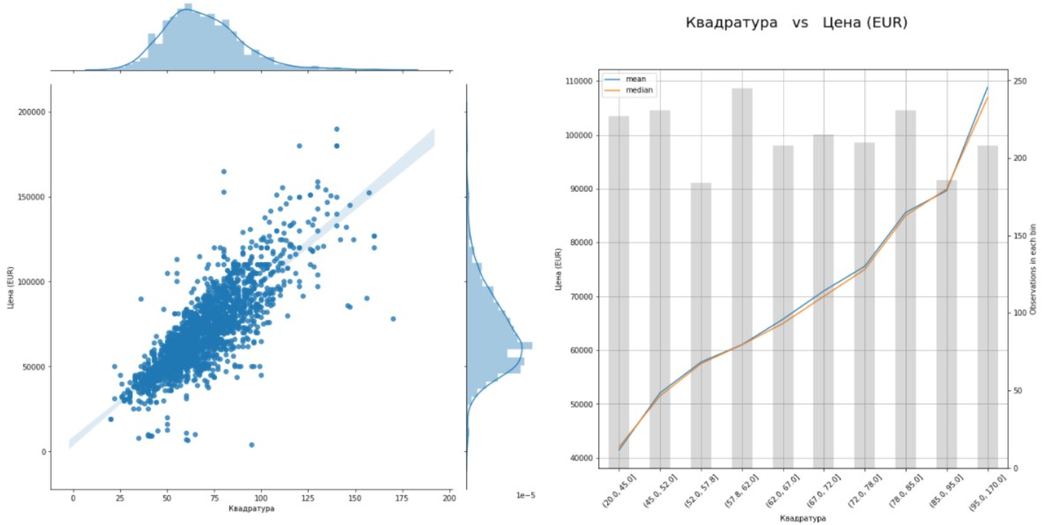
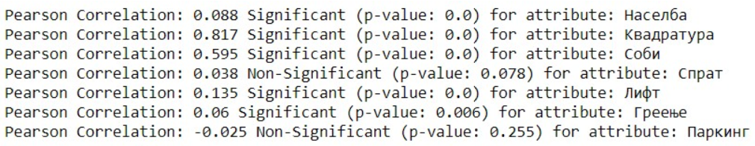
Feature Interactions & Importance
Surface is predictive: on average, the larger the apartments the higher the price
H0: two variables are independent (no linear relationship), If the p-value < 0.05, the null hypothesis rejected – dependent variables
Gradient BoostRegressor – features importance
5 features have the greatest impact in the final decision, “Паркинг” is the least significant one but yet important

Slide 9
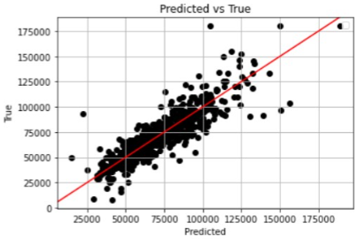
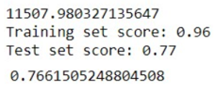

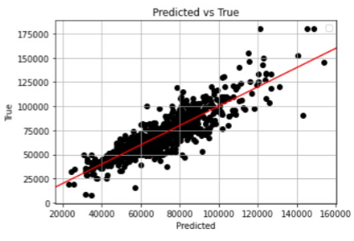
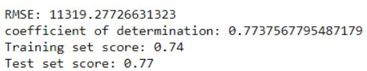
ML (Regression) Models
Train-test set split: 70%-30%.
Data standardization - in most cases worse performance
RMSE and R-squared (coefficient of determination)
XGBoost – DT ensemble, additive training strategy (boosting)
KNN Regression
Polynomial Regression ( d=2 ) – curvilinear relationship, includes a polynomial term
Linear Regression, Logistic Regression, SVR – poor performance

Slide 10
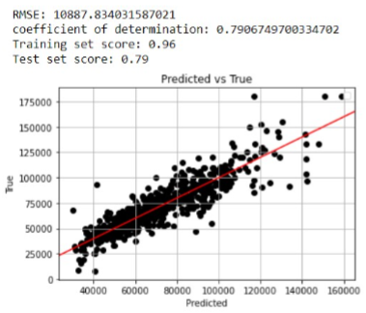
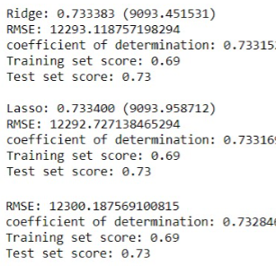
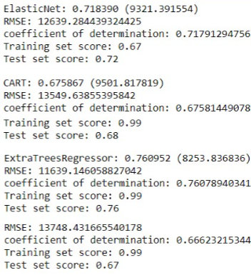
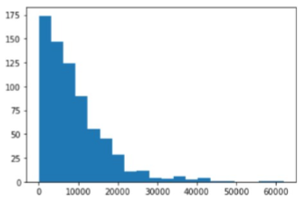
ML (Regression) Models
Random Forest Regressor - bagging technique (not boosting), trees run in parallel, no interaction, mean prediction of all
Ridge Regression, Lasso Regression –optimizations: L1 (Lasso, zero w) and L2 (Ridge, minimal w) regularization
ElasticNet (L1, L2 penalty, OLS cost)
Bayesian Ridge Regression (normal distribution of errors in model)
CART, DT Regressor, Extra-Trees Regressor (random split, not optimal)
Ada Boost Regressor
Bagging Regressor – XGBoost

Slide 11
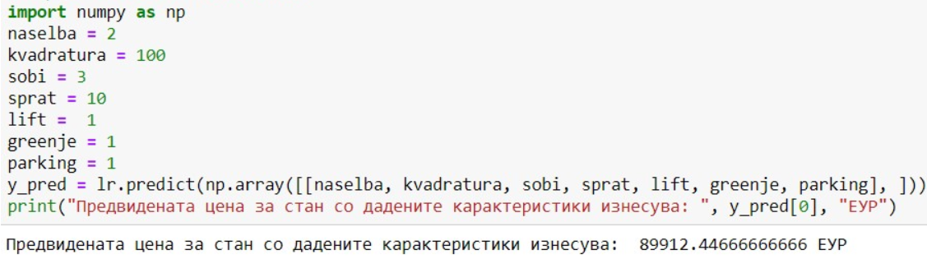
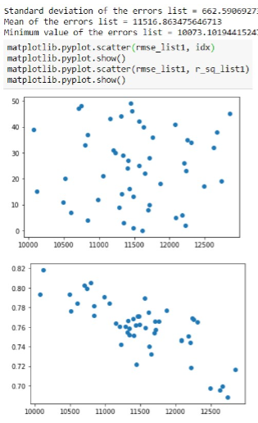
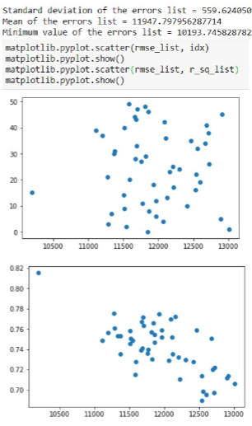
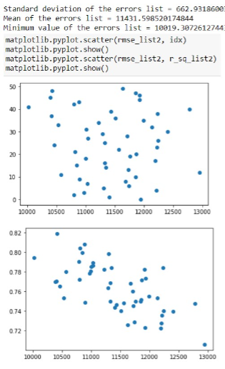
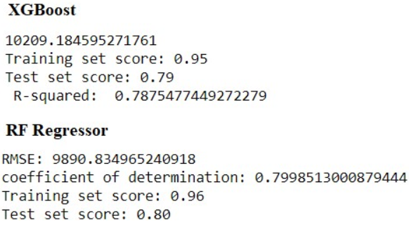
Repeated K-fold CV and Hyper-parameter tuning
XGBoost, Polynomial and RF Regression
k*repetitions different model estimation errors to choose different partitions for training and testing
Model Bias = average of errors, lower – better model
Model Variance = standard deviation of all the errors (low value suggests our model does not vary a lot with different subsets)
Grid Search – finding the best parameters for the XGBoost model

Slide 12
Conclusion
A lot data entries dropped while cleaning
More data (websites) are very welcomed
Web scraping and model retraining can be automated using Airflow schedulers
Introduce some type of geolocation/distance attributes (coordinates of every apartment in our data compared with a (desirable) point in the city center)
RF Regressor is the best model for prediction of apartment prices.
Consultative tool to help people approximately predict the budget for their new homes in Skopje.

Slide 13
Thank you for your Attention!

